Slide 1
Electric Vehicle Stock Market

Slide 2
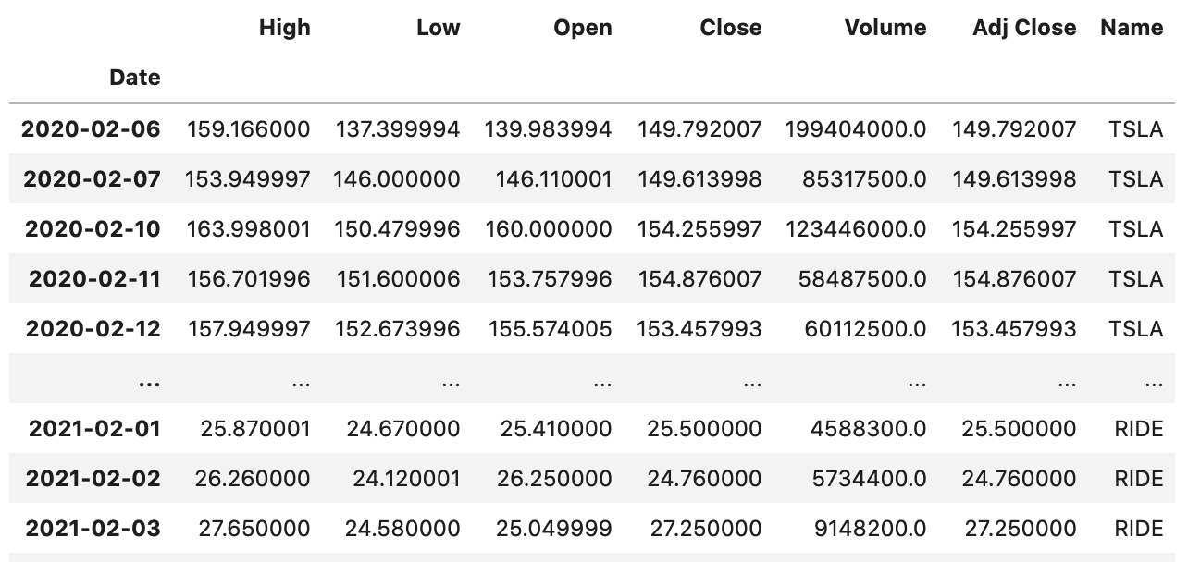
Dataset
Popular EV Stock Tickers
TESLA (TSLA)
NIO (NIO)
Workhorse (WKHS)
XPENG (XPEV)
General Motors (GM)
Nikola (NKLA
Fisker (FSK)
Kandi Technologies (KNDI)
Lordstown Motors (RIDE)
Traditional Energy
WTI OIL (Western Texas Intermediate)
Data was collected using Python package pandas_datareader and yfinance
Data includes typical stock dataset columns: Date(index), High, Low, Open, Close, Volume, Adj Close.
Interval/Period: 1 Year back from now

Slide 3
Why Electric Vehicles
OIL is known as ‘black gold’ and has been used since 3000 BC. However, Oil is still a limited resource and it will come to the end eventually. Alternative energies like wind,solar, electricity etc have great potential to replace Oil
Electricity energy is cheaper and renewable
Better for Environment
Health Benefits
Electric car looks cool :)

Slide 4
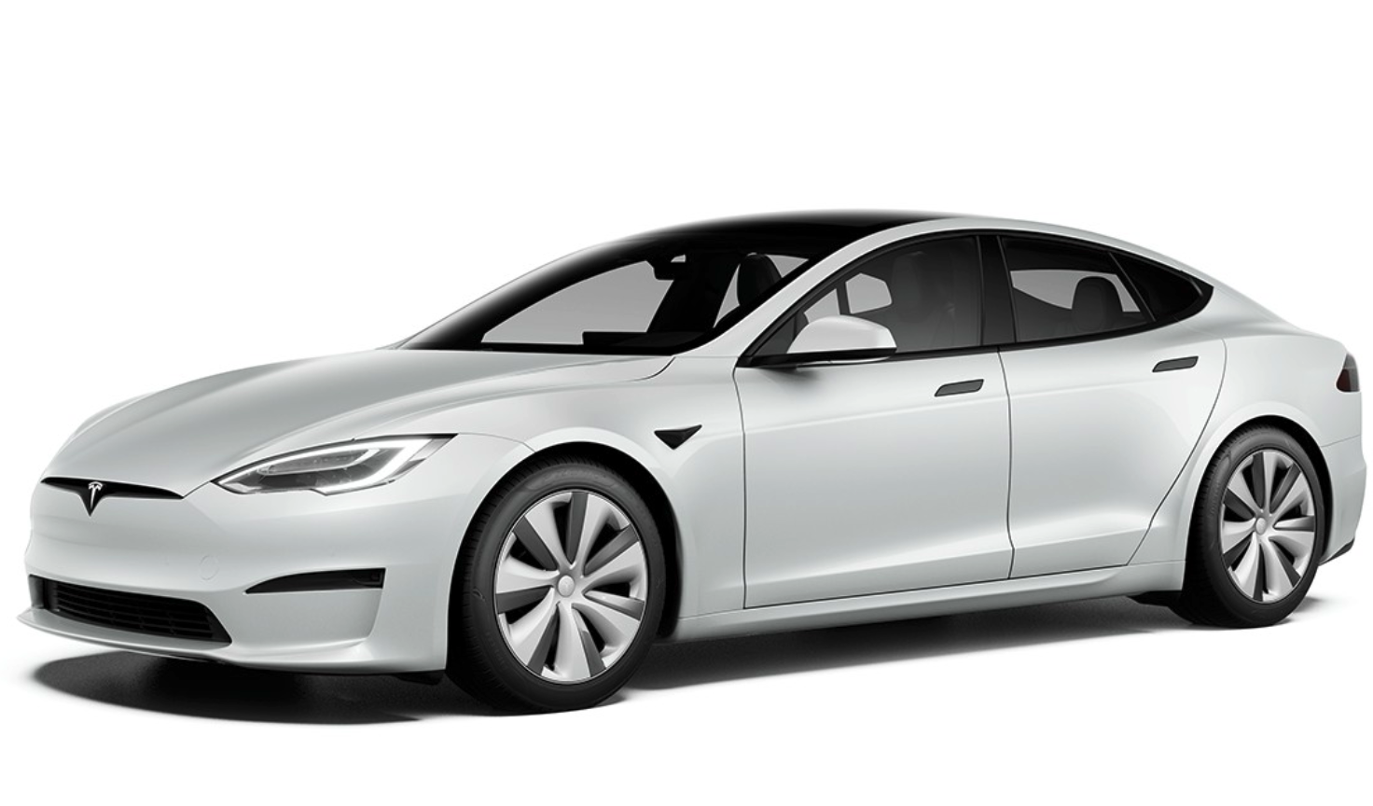
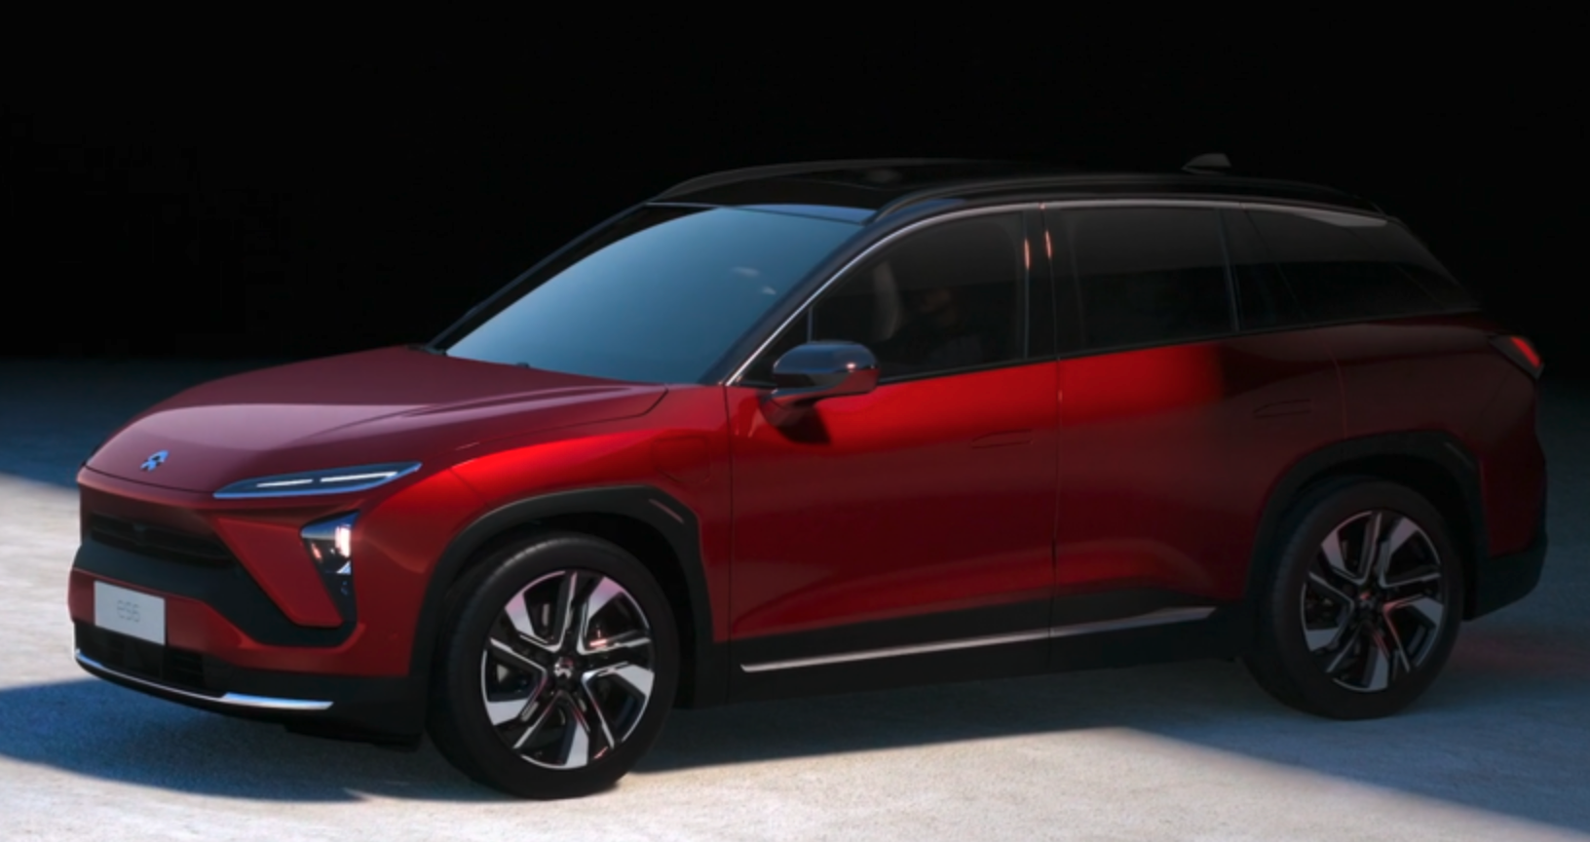
TESLA Model S
NIO ES6

Slide 5
Business Questions
EV stocks come from different indices. Should we invest in some different EV stocks in our portfolio?
EV stocks tend to have some sort of relationships. Can we make decision to buy/sell one EV stock based on another EV stock?
OIL and EV seem to be opposite. Are there any insights to make investing decision based on relationships between them?

Slide 6
Analysis Questions
What are the correlations between EV stocks opening and closing prices?
What are the correlations between EV stocks daily returns?
Are there any cointegrated relationships between EV stocks?
Are there any correlations and cointegrated relationships between EV stocks and OIL?

Slide 7
Data Pipeline
Data Acquisition and Exploration
Cleaning, concatenating stocks, finding correlations, cointegrations, etc
Domain Knowledge and Business Question
Gain understanding in financial market, techniques and how to apply data science
Analysis
Finding relationship and meaningful information from the acquired dataset (i.e: in which situations the findings are useful, etc).
Perform Linear Regression
Presentation
Walk audiences through the findings

Slide 8
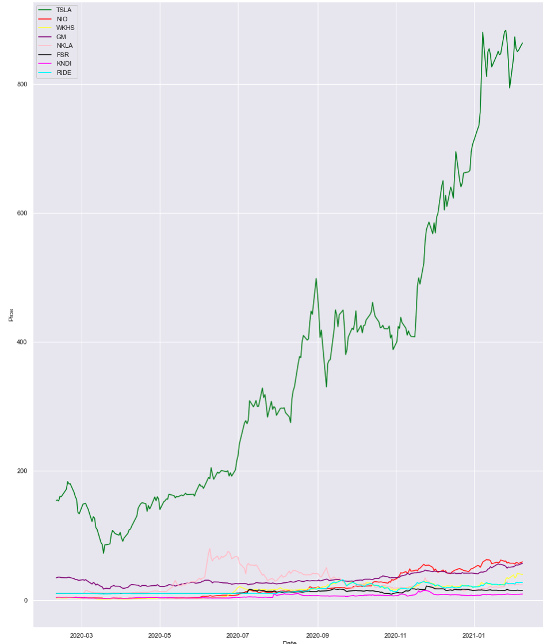
Quick Data Visualisation

Slide 9
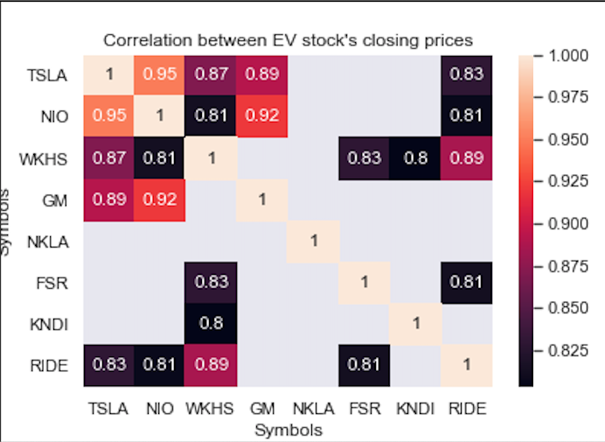
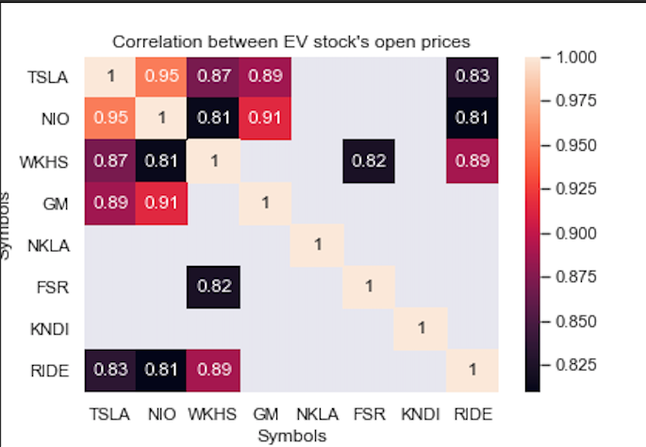
Pearson Correlation between EV’s stock open and closing prices

Slide 10
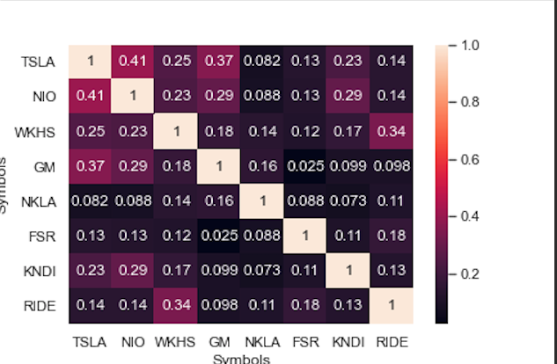
Pearson Correlation between EV’s stock daily return

Slide 11

Why correlation between stocks matter here?
Diversification is the practice of spreading your investments around so that your exposure to any one type of asset is limited. This practice is designed to help reduce the volatility of your portfolio over time.

Slide 12
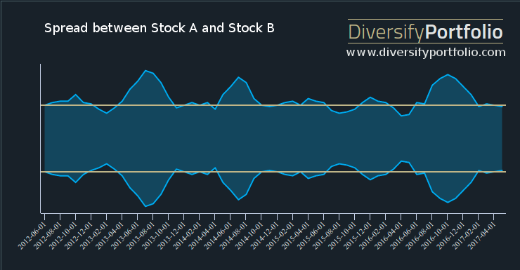
Cointegration and Pairs Trading between EV Stocks
Pairs Trading is a concept of going long and short two stocks simultaneously
Cointegration is a popular method to find stocks for pairs trading strategies.
A builtin Python function to find cointegration
from statsmodels.tsa.stattools import coint

Slide 13
Hypothesis for Cointegration
Ho: There is no cointegration
Ha: There is cointegrating relationship
If the pvalue is small, below a critical size, then we can reject the hypothesis that there is no cointegrating relationship.

Slide 14
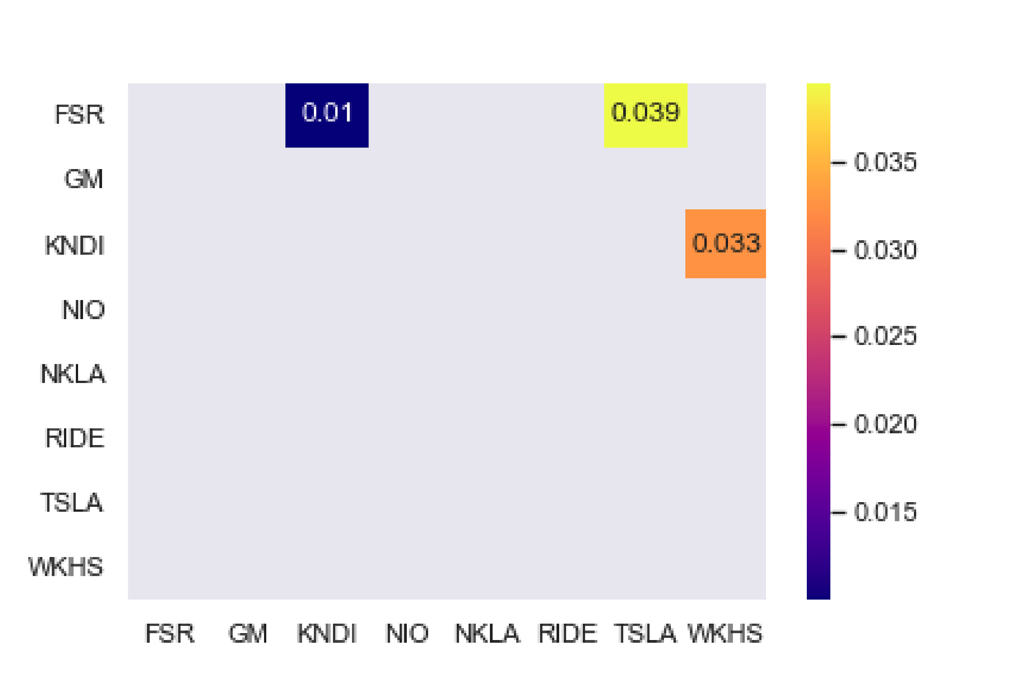
Cointegration between EV stocks
Heat map of p-values
Confidence Interval: 5% (theoretically it must be 1% :) 😋

Slide 15
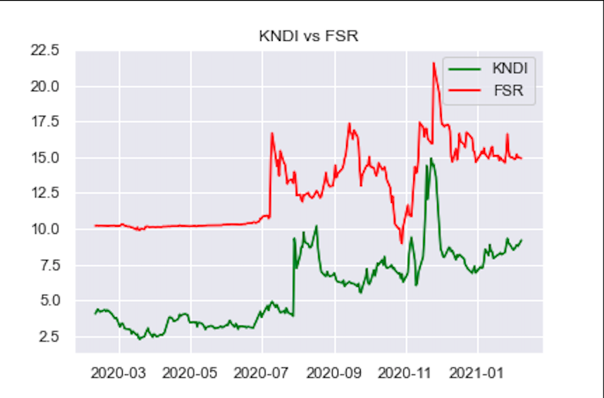
Let see if they have that patterns

Slide 16

OIL versus EV stocks

Slide 17
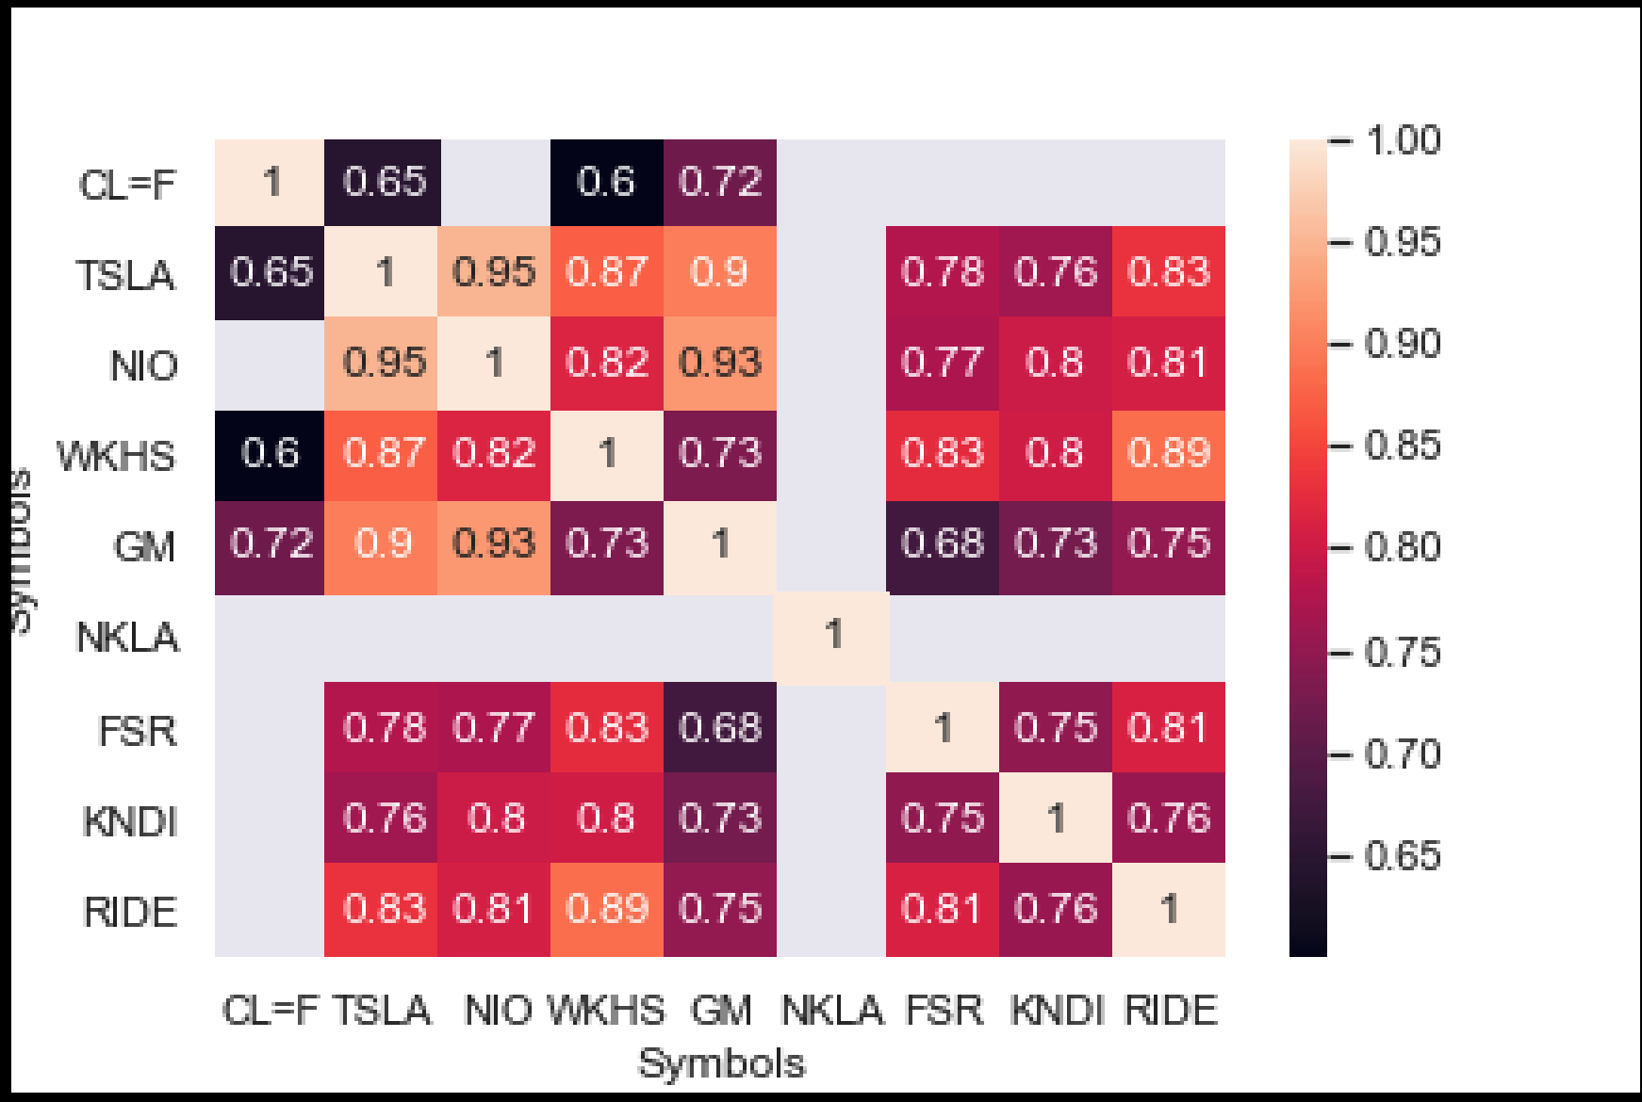
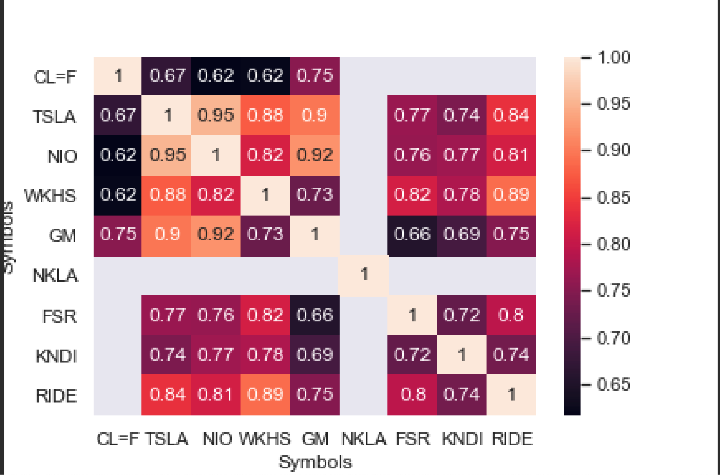
Pearson Correlation between EV’s stock vs OIL open and closing prices (>60%)
Close
Open

Slide 18
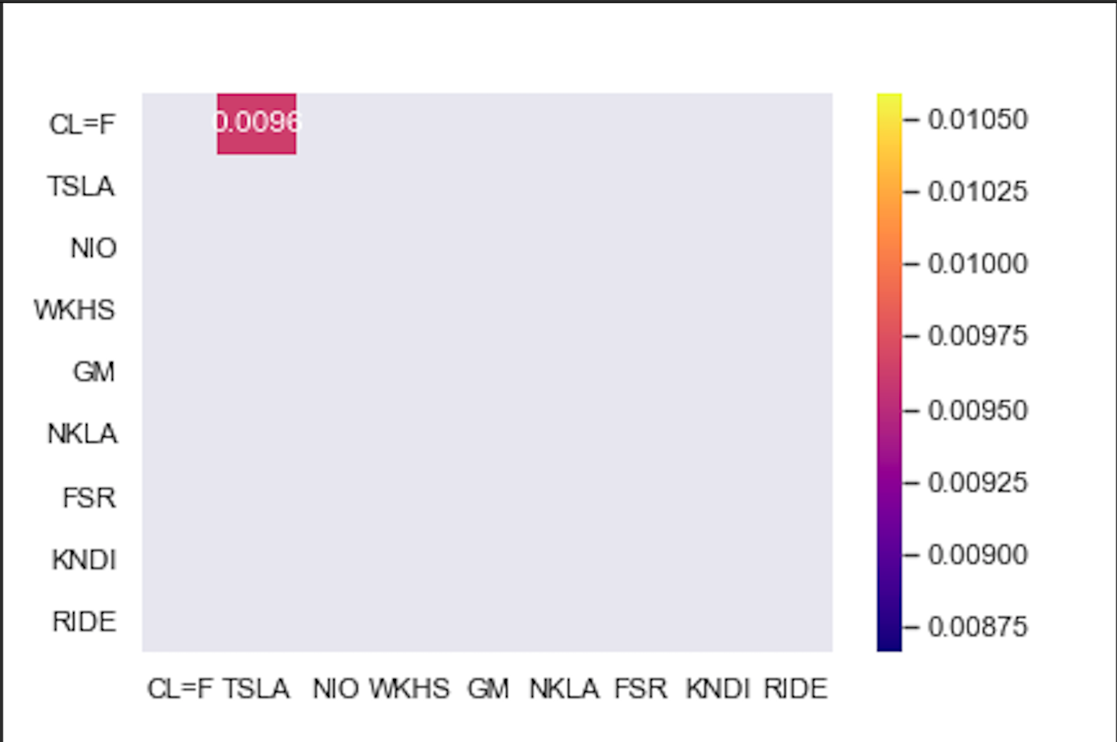
Cointegration between EV stocks and OIL
Heat map of p-values
Confidence Interval: 1%
Start=2020-08-15
End=2021-02-07

Slide 19
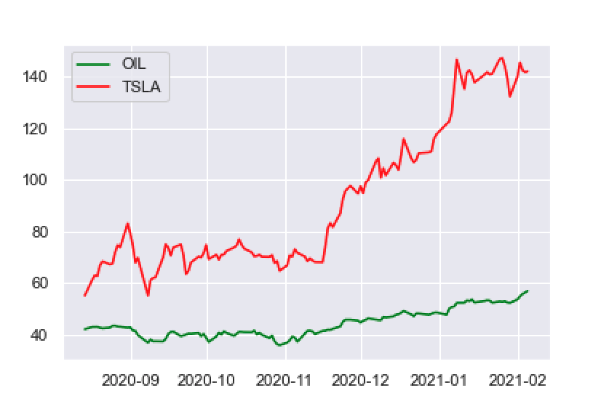
Cointegration between EV stocks and OIL
TESLA price was divided by 6 to make it easier to visualise the pattern

Slide 20
Linear Regression for TESLA closing price

Slide 21
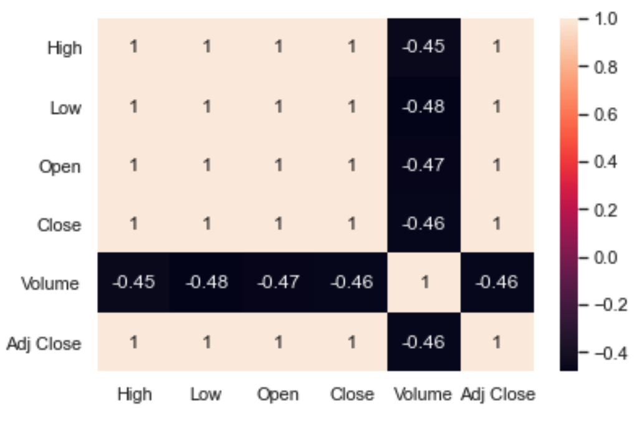
Linear Regression - Predict/Forecast Tesla price

Slide 22
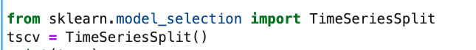
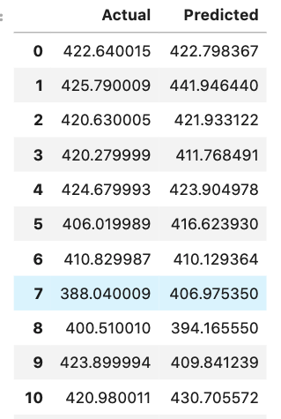
Linear Regression - Predict/Forecast Tesla price (cont.)
Linear Regression - Predict/Forecast Tesla price
X = Open and Volume
Y = Adj Close
For splitting timeseries data, using TimeSeriesSplit instead of train_test_split

Slide 23
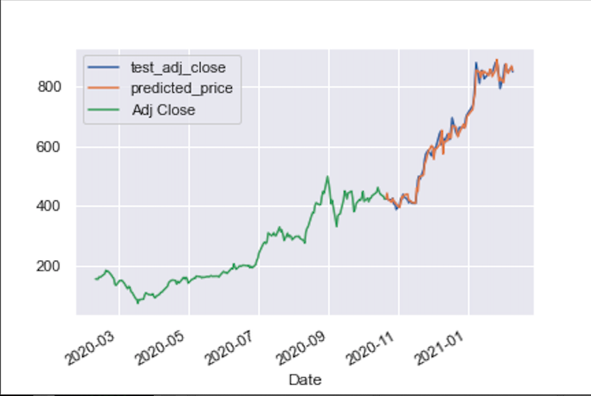
Linear Regression - Predict/Forecast Tesla price (cont.)
Linear Regression - Predict/Forecast Tesla price
R squared score: 98.75%

Slide 24
Conclusion
Many EV stocks have strong positive correlations. Consider diversifying your portfolio with low correlated EV's stock and with other sectors
FSR and KNDI are two great EV stock based on their cointegration value for Pairs Trading. More professional analysis need to be done
With the selected EV stocks, Tesla, Nio, General Motors and Workhorse have positive correlation in their closing and opening prices. Be careful and consider diversification in your investing portfolio
p-value for cointegrating relationship between Tesla and Oil indicated they are a good pair to trade. However, the line chart does not clearly show it. More analysis need to be done
Never trust any stock predicting model to make your investing decision unless you know well what you are doing

Slide 25
Thank you for your attention

